Slide 1
Spring Boot Actuator

Slide 2
What is Actuator?
Actuator brings production-ready features to our application.
Monitoring our app
gathering metrics, understanding traffic or the state of our database becomes trivial with this dependency.
The main benefit of this library is that we can get production grade tools without having to actually implement these features ourselves.
Actuator is mainly used to expose operational information about the running application – health, metrics, info, dump, env, etc. It uses HTTP endpoints or JMX beans to enable us to interact with it.
Once this dependency is on the classpath several endpoints are available for us out of the box. We can easily configure or extend it in many ways.

Slide 3
What is Actuator?
Hence Spring Actutator provides HTTP End points which can be invoked to get details(memory, GC details, beans, logs, heapdump, and many many more…) of running Application.
Above end points can be used directly by Developer or some other Tools, to Monitor, Tune, Troubleshoot Application under Development or in Production.
To enable Spring Boot Actuator we’ll just need to add the
spring-boot-starter-actuator dependency to our package manager.
Below is sample POM.xml snippet
1 2 3 4 | <dependency> <groupId>org.springframework.boot</groupId> <artifactId>spring-boot-starter-actuator</artifactId> </dependency>

Slide 4
Spring Boot 1.x
In 1.x Actuator follows a R/W model, that means we can either read from it or write to it. E.g. we can retrieve metrics or the health of our application. Alternatively, we could gracefully terminate our app or change our logging configuration.
Actuator requires Spring MVC to expose its endpoints through HTTP.
In 1.x, Actuator brings its own security model. It takes advantage of Spring Security constructs, but needs to be configured independently from the rest of the application.
Also, most endpoints are sensitive – meaning they’re not fully public, or in other words, most information will be omitted – while a handful is not e.g. /info.
Specify below property in application.proeprties for end points to workl
management.security.enabled=false

Slide 5
Spring Boot 1.x
Here are some of the most common endpoints Boot provides out of the box:
/health – Shows application health information (a simple ‘status’ when accessed over an unauthenticated connection or full message details when authenticated); it’s not sensitive by default
/info – Displays arbitrary application info; not sensitive by default
/metrics – Shows ‘metrics’ information for the current application; it’s also sensitive by default
/trace – Displays trace information (by default the last few HTTP requests)
/beans – All beans created by Spring, in current Project
/autoconfig – AutoConfigurations picked by Spring Boot
/heapdump – downloads current heapdump
Pls check console when Application is running to get complete list of end points

Slide 6
Spring Boot 1.x
Here are some of the most common endpoints Boot provides out of the box:
/health – Shows application health information (a simple ‘status’ when accessed over an unauthenticated connection or full message details when authenticated); it’s not sensitive by default
/info – Displays arbitrary application info; not sensitive by default
/metrics – Shows ‘metrics’ information for the current application; it’s also sensitive by default
/trace – Displays trace information (by default the last few HTTP requests)
/beans – All beans created by Spring, in current Project
/autoconfig – AutoConfigurations picked by Spring Boot
/heapdump – downloads current heapdump
Pls check console when Application is running to get complete list of end points

Slide 7
Spring Boot 1.x
Each endpoint can be customized with properties using the following format: endpoints.[endpoint name].[property to customize]
Three properties are available:
id – by which this endpoint will be accessed over HTTP
enabled – if true then it can be accessed otherwise not
sensitive – if true then need the authorization to show crucial information over HTTP
For example, add the following properties will customize the /beans endpoint:
endpoints.beans.id=springbeans
endpoints.beans.sensitive=false
endpoints.beans.enabled=true

Slide 8
Spring Boot 1.x
/health Endpoint
The /health endpoint is used to check the health or state of the running application.
Health information is collected from all the beans implementing the HealthIndicator interface configured in our application context.
Some information returned by HealthIndicator is sensitive in nature – but we can configure endpoints.health.sensitive=false to expose more detailed information like disk space, messaging broker connectivity, custom checks etc.
We can also implement our own custom health indicator – which can collect any type of custom health data specific to the application and automatically expose it through the /health endpoint:

Slide 9
Spring Boot 1.x
Besides using existing end points, we can also provide additional end points.
we need to have the new endpoint implement the Endpoint<T> interface
@Component
public class CustomEndpoint implements Endpoint<List<String>> {
@Override
public String getId() {
return "customEndpoint";
}
@Override
public boolean isEnabled() {
return true;
}
@Override
public boolean isSensitive() {
return true;
}
@Override
public List<String> invoke() {
// Custom logic to build the output
List<String> messages = new ArrayList<String>();
messages.add("This is message 1");
messages.add("This is message 2");
return messages;
}
}

Slide 10
Spring Boot 1.x
In order to access this new endpoint, its id is used to map it, i.e. we could exercise it hitting /customEndpoint.
Output:
[ "This is message 1", "This is message 2" ]
Further Customization(in application.properties file]:
#port used to expose actuator
management.port=8081
#CIDR allowed to hit actuator, White listing, requests from only below IP addr are allowed
management.address=127.0.0.1
#Whether security should be enabled or disabled altogether
management.security.enabled=false
If the application is using Spring Security – we can secure these endpoints by defining the default security properties – username, password, and role – in the application.properties file:
security.user.name=admin
security.user.password=secret
management.security.role=SUPERUSER

Slide 11
Spring Boot 2.x
IN Spring Boot 2.x most of end points are disabled by default, you need to enable by using below
management.endpoints.web.exposure.include=*
To include a specific end points use comma separated, as below
management.endpoints.web.exposure.include=health,info
Check all enabled end points, using below URL
http://localhost:8080/actuator/
All End points specified below
https://docs.spring.io/spring-boot/docs/current/reference/html/production-ready-endpoints.html
NOTE: end point names need to be prefixed with /actuator, for eg
http://localhost:8080/actuator/mappings

Slide 12
Spring Boot 2.x
/beans – returns all available beans in our BeanFactory. Unlike /auditevents, it doesn’t support filtering
/conditions – formerly known as /autoconfig, builds a report of conditions around auto-configuration
/httptrace - to show last few HTTP requests
/configprops – allows us to fetch all @ConfigurationProperties beans
/env – returns the current environment properties. Additionally, we can retrieve single properties
/flyway – provides details about our Flyway database migrations
/health – summarises the health status of our application
/heapdump – builds and returns a heap dump from the JVM used by our application
/info – returns general information. It might be custom data, build information or details about the latest commit /mappings
/liquibase – behaves like /flyway but for Liquibase
/logfile – returns ordinary application logs
/mappings - list of HTTP mapping end points
/loggers – enables us to query and modify the logging level of our application
/metrics – details metrics of our application. This might include generic metrics as well as custom ones
/prometheus – returns metrics like the previous one, but formatted to work with a Prometheus server
/scheduledtasks – provides details about every scheduled task within our application
/sessions – lists HTTP sessions given we are using Spring Session
/shutdown – performs a graceful shutdown of the application - HTTP POST
/threaddump – dumps the thread information of the underlying JVM

Slide 13
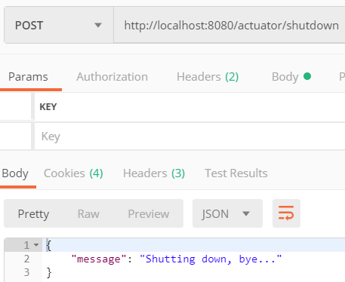
Spring Boot 2.x
/shutdown endpoint:
Below properties need to be specified in app.properties file
management.endpoints.web.exposure.include=*
management.endpoint.shutdown.enabled=true
Supported as HTTP POST. Use Postman to send
this request
/metrics endpoint:
{
"names": [
"jvm.gc.pause",
"jvm.buffer.memory.used",
"jvm.memory.used",
"jvm.buffer.count",
// ...
]
}

Slide 14
Spring Boot 2.x
Enable LOggers for a specific component:
To change the log level of the root logger to DEBUG at runtime, make a POST request to the URL http://localhost:8080/actuator/loggers/root with the following payload -
{ "configuredLevel": "DEBUG" }
It can be reset using null

Slide 15
Spring Boot 2.x
We can also get Build and related details from an End Point using /info End Point
Below are changes required for the same.
TO get git details
<dependency>
<groupId>pl.project13.maven</groupId>
<artifactId>git-commit-id-plugin</artifactId>
</dependency>
We can also get build information including name, group, and version
<plugin>
<groupId>org.springframework.boot</groupId>
<artifactId>spring-boot-maven-plugin</artifactId>
<executions>
<execution>
<goals>
<goal>build-info</goal>
</goals>
</execution>
</executions>
</plugin>

Slide 16
Spring Boot 2.x
To further queries more details
/actuator/metrics/jvm.gc.pause and get a detailed response:
{
"name": "jvm.gc.pause",
"measurements": [
{
"statistic": "Count",
"value": 3.0
},
{
"statistic": "TotalTime",
"value": 7.9E7
},
{
"statistic": "Max",
"value": 7.9E7
}
],
Good reference:
https://www.callicoder.com/spring-boot-actuator/
"availableTags": [
{
"tag": "cause",
"values": [
"Metadata GC Threshold",
"Allocation Failure"
]
},
{
"tag": "action",
"values": [
"end of minor GC",
"end of major GC"
]
}
]
}

Slide 17
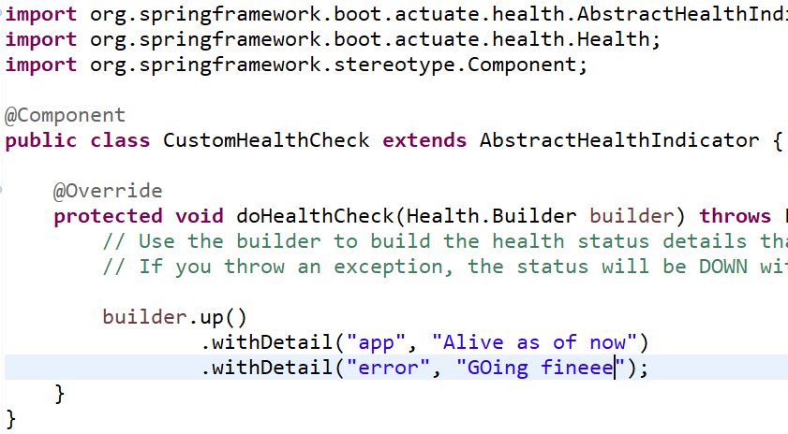
Spring Boot 2.x
Customize an existing end point:
It is possible to customize an existing end point, and provide additional details.
as shown below
Below URL shows, how to generate UI using Actuator
https://dzone.com/articles/monitoring-using-spring-boot-20-prometheus-and-gra

Slide 18
Spring Boot 2.x
Securing Actuator: When Spring Security is enabled, actuator end points are by default secured by form based authentication, you need to provide the credentials to access the end points

Slide 19

Spring Boot 2.x
Let’s create an Actuator endpoint to query, enable and disable feature flags in our application:
@Component
@Endpoint(id = "features")
public class FeaturesEndpoint {
private Map<String, Feature> features = new ConcurrentHashMap<>();
//…
}
Above End Point can be accessed using /actuator/features
Once you are comfortable with all above Actuator details, then only you may refer below URL(optional)
https://docs.spring.io/spring-boot/docs/current/reference/html/production-ready-endpoints.html
Name of new custom end point

